Slide 1

Data Science Metrics

Slide 2
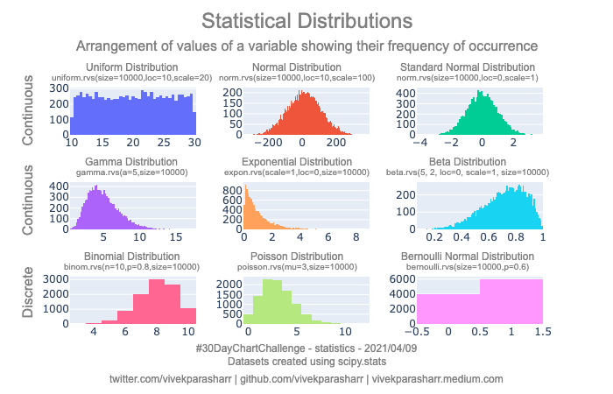
Distributions

Slide 3
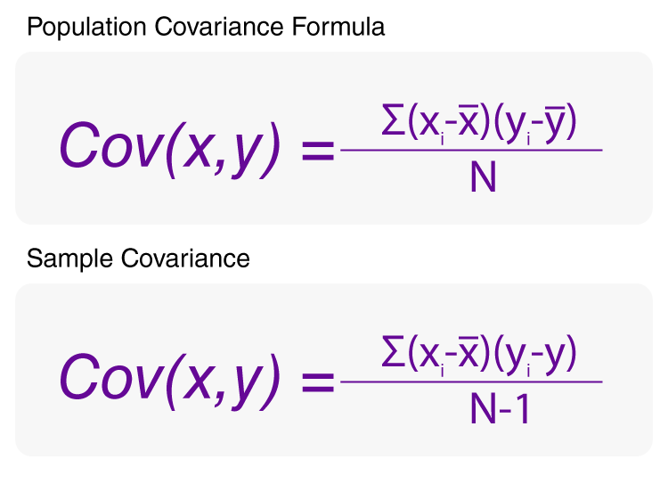
Covariance
Covariance describes the relationship between two variables

Slide 4
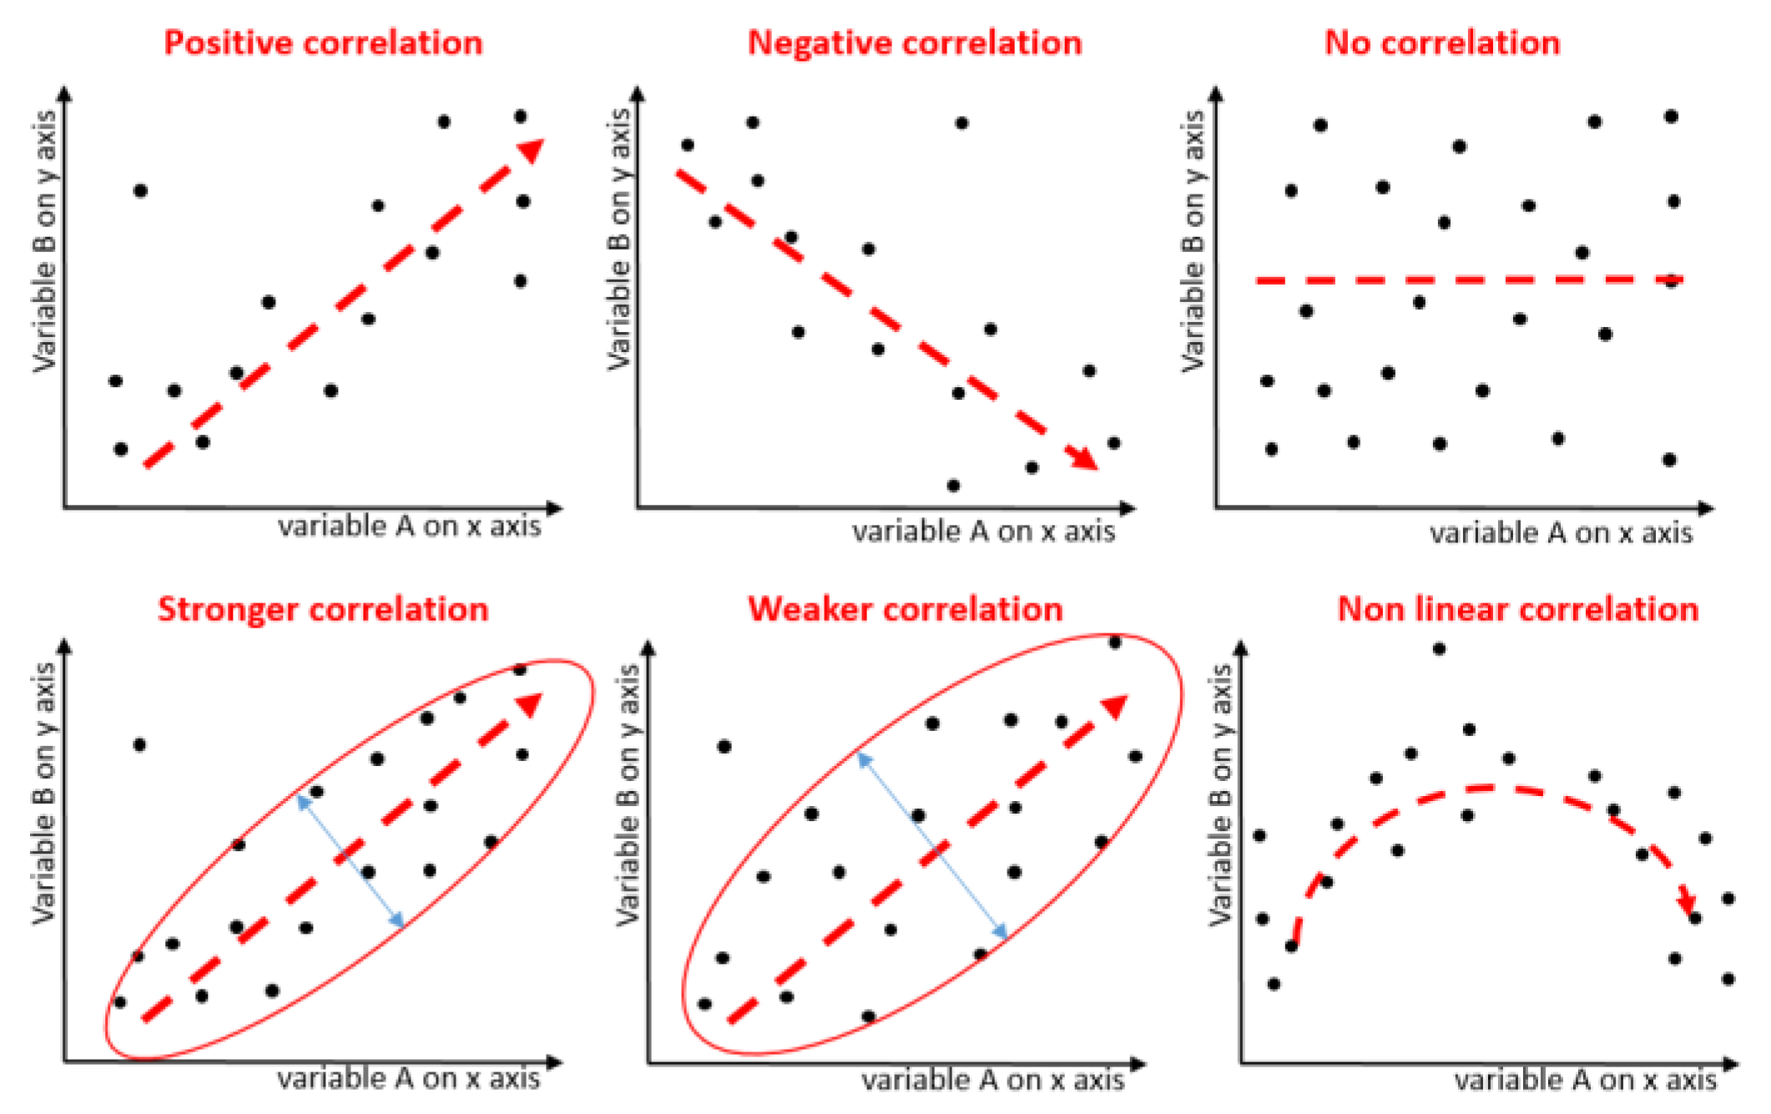
Correlation

Slide 5
Residuals

Slide 6
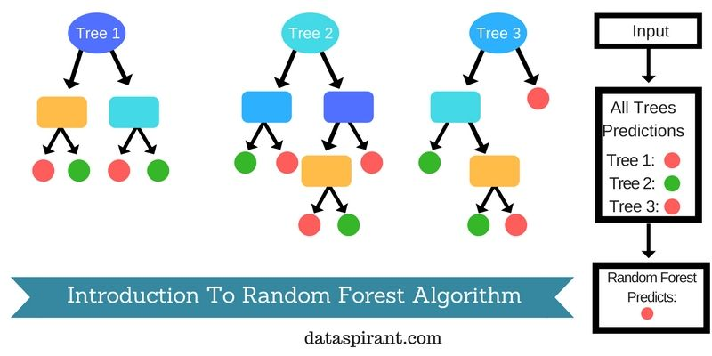
Random Forest
https://dataaspirant.com/random-forest-algorithm-machine-learing/

